Slide 1
ECONOMIC CONVERSION
Taking Steps Towards a New Sustainable Economy
Produced by U.S. Labor Against the War (USLAW)
1718 M Street, NW, #153, Washington, DC 20036
Voicemail: (202) 521-5265
info@uslaboragainstwar.org Twitter: @USLAWLeader
Facebook: labor.against.war www.uslaboragainstwar.org

Slide 2
ECONOMIC CONVERSION
Taking Steps Towards a New Sustainable, Demilitarized and Just Economy

Slide 3
OUR COUNTRY SUFFERS FROM A MILITARY-INDUSTRIAL COMPLEX

Slide 4
WHAT IS “ECONOMIC CONVERSION”?
Also called “defense transition”

Slide 5
MOVE FROM A MILITARY/FOSSIL FUEL-DOMINATED INEQUITABLE, CONSUMERIST ECONOMY TO A CIVILIAN ECONOMY THAT IS DEMILITARIZED SUSTAINABLE AND JUST

Slide 6
WHY DO WE NEED ECONOMIC CONVERSION?

Slide 7
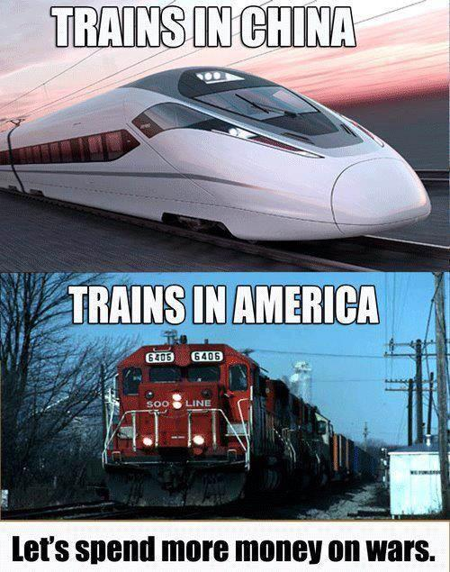
A MILITARIZED ECONOMY: UNPRODUCTIVE
Money to finance weapons and wars displaces productive investment and uses up national resources

Slide 8
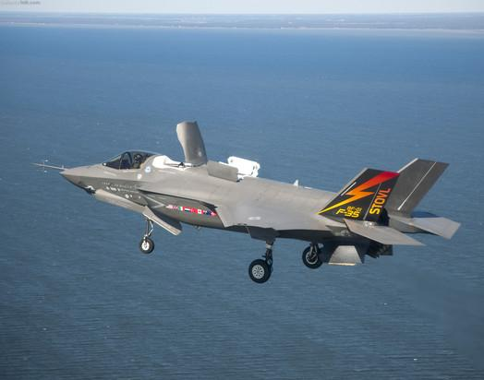
A MILITARIZED ECONOMY: INEQUITABLE
Money spent on the military is diverted from social goods (e.g., education, health care)
A strong economy requires strong people—and investment in people

Slide 9
A MILITARIZED ECONOMY: BAD FOR ALL OF US
The more a country spends on the military as a share of its economy:
The slower the economic growth
The higher the unemployment
The slower the productivity growth
The less innovation
The greater its contribution to global warming
Source: Council on Economic Priorities

Slide 10
A MILITARIZED ECONOMY: PRODUCES FEWER JOBS U.S. JOB CREATION WITH $1 BILLION
Number of Jobs Created
Education Health Care Clean Energy Consumption Military
Source: Pollin & Garrett-Peltier, 2009

Slide 11
A MILITARIZED ECONOMY: PUTS BUSINESS AT A COMPETITIVE DISADVANTAGE
Source: National Science Foundation

Slide 12
AMONG ALL COUNTRIES, WE ARE NUMBER ONE IN MILITARY SPENDING, BUT:
11th : Percent of 25-34 year-olds who have graduated high school
22nd: Broadband Internet access
24th: Life expectancy at birth
32nd: Infant mortality rate
48th: Quality of K-12 science and math
Sources: National Academies Press; UN Social Indicators

Slide 13
2013 REPORT CARD FOR U.S. INFRASTRUCTURE AMERICAN SOCIETY OF CIVIL ENGINEERS
Aviation D
Bridges C+
Dams D
Drinking water D
Energy D+
Hazardous Waste D
Inland waterways D-
Levees D-
Ports C
Public Parks & Recreation C-
Rail C
Roads D
Schools D
Solid Waste B-
Transit D
Wastewater D
Source: American Society of Civil Engineers

Slide 14
ECONOMIC COSTS OF MILITARISM:
We have less to invest in new businesses and new ways of doing things—our economy is weaker.
We have less to spend on health, education, infrastructure, art and culture.
We all have to work harder and longer hours, just to stay even.
We endanger the climate and the ability of human beings to live on earth.

Slide 15
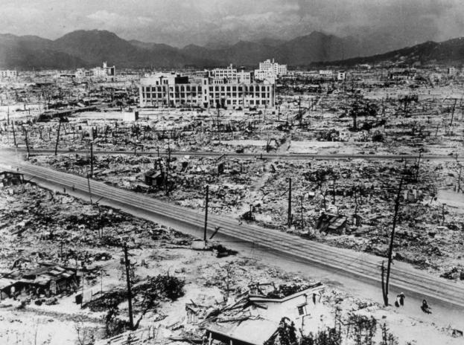
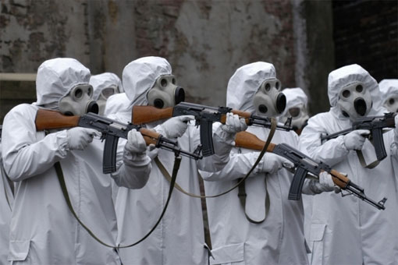
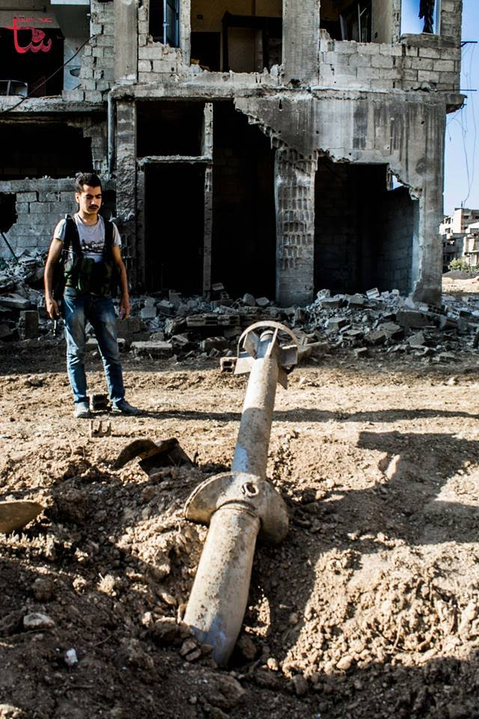
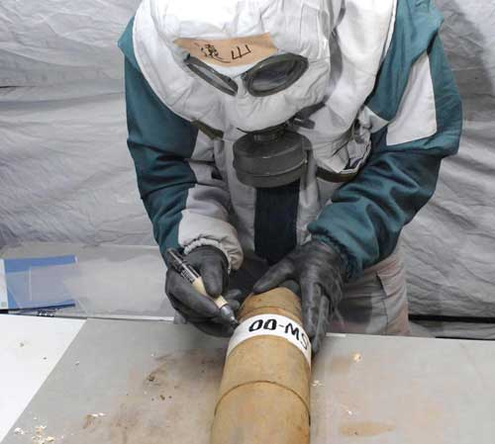
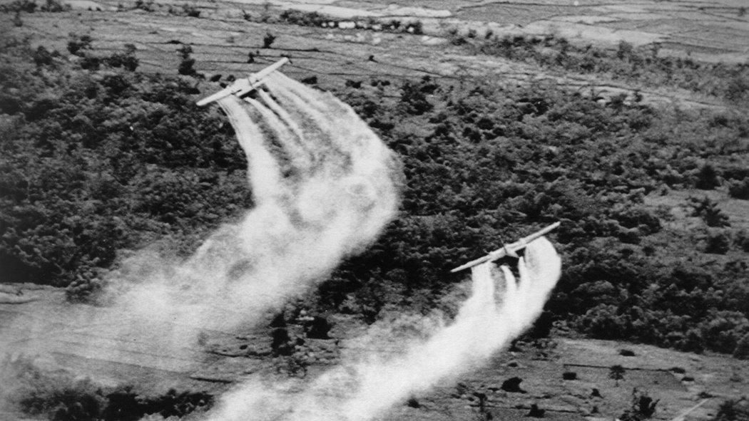
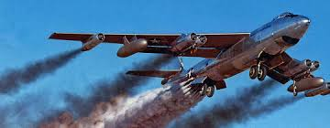
ENVIROMENTAL COSTS OF MILITARISM:
War is a dirty business
The US military is the largest consumer of fossil fuels and biggest emitter of CO2 pollutants on the planet.

Slide 16
IS THE U.S. ECONOMY MILITARIZED?

Slide 17
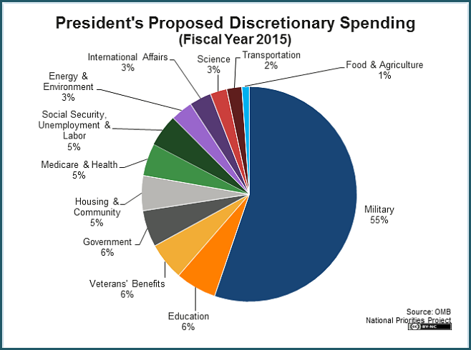

Slide 18
WHERE YOUR 2014 INCOME TAXES WENT
Source: New Priorities Project

Slide 19
MILITARY EXPENDITURES PER CAPITA
Source: Friedman and Preble

Slide 20
Source: National Priorities Project

Slide 22
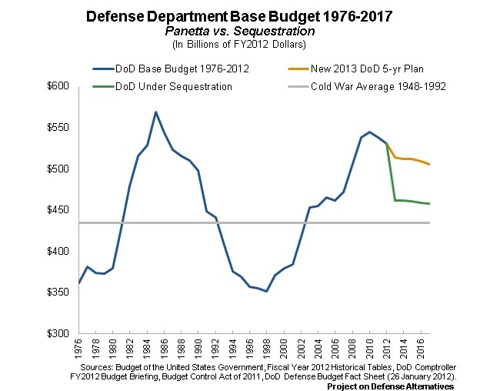

Slide 23
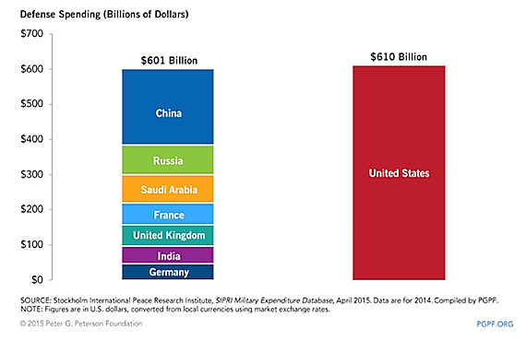
U.S. MILITARY SPENDING VS. OTHER COUNTRIES, IN RANK ORDER, FY 2014
Source: Computed from SIPRI
Notes:
Figuring out ways to help workers and communities as we move away from dependence on military spending. I’m going to make a legislative proposal, but first I want to explain why we think it is necessary.
23

Slide 24
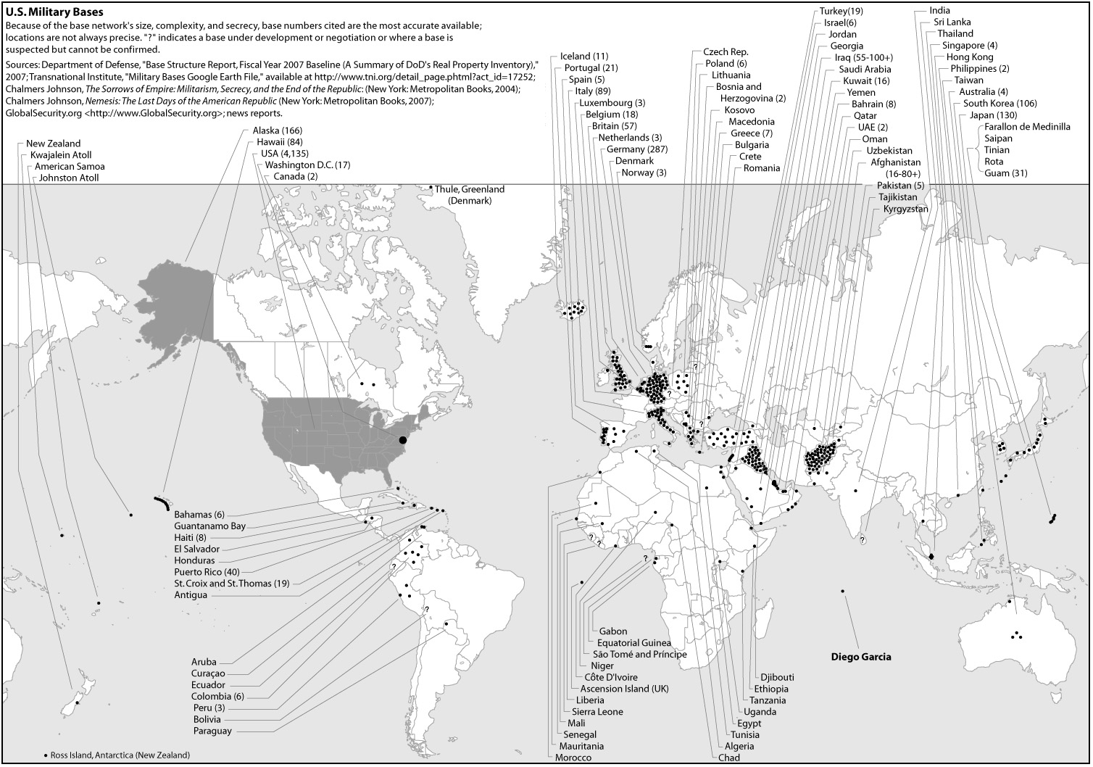
U.S. Foreign Military Bases
Notes:
Some people believe that a side benefit of military spending is that the military creates jobs and so that alone is a reason to maintain a large military. However, a recent analysis found that other sectors created more jobs than the military, as this chart shows. Thus, if Pentagon spending is preserved at current levels, it will result in a net loss of jobs nationwide.
A study in 2012 found that in spite of greatly increased contracts and money, the largest Pentagon contractors had cut the number of workers: http://pogoblog.typepad.com/pogo/2012/08/defense-contractor-time-machine-less-spending-more-jobs-analysis-reveals.html
Virtually all economic models project that military spending leads to job loss over the long term. (Baker, Dean, 2007, Center for Economic and Policy Research)
24

Slide 25
“DEFENSE” SPENDING?
From the Cato Institute:
“In a literal sense, the United States does not have a defense budget. The adjective is wrong. . . Our global military posture and activism drag us into others’ conflicts, provoke animosity, cause states to balance our power, and waste resources. We need a defense budget worthy of the name.”
Source: Cato Web Site

Slide 26
ABOUT THAT DEFICIT . . .
26

Slide 27
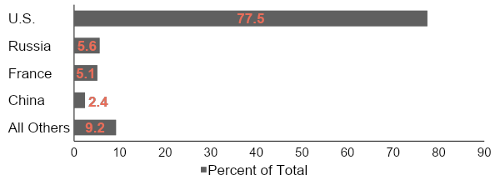
U.S.—ARMS DEALER TO THE WORLD
Arms Transfer Agreements with the World
By Supplier, 2011
Source: Congressional Research Service, Aug. 2012

Slide 28
ISN’T MILITARY SPENDING GOING DOWN?
Sequester:
$500 bn cut over 10 years—17% in real terms
Will bring spending down to 2006 level
Source: Friedman & Logan;

Slide 29
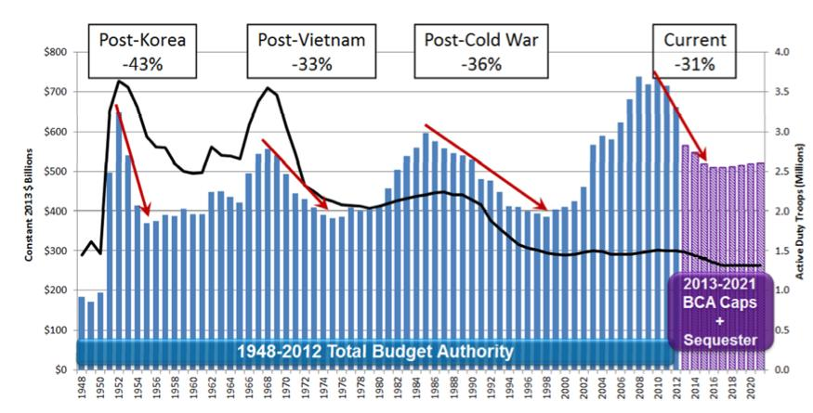
Post-War Military Spending

Slide 30
What do we mean by
“national security”?
Real security includes --
A stable job that pays a living wage
Healthcare as a right, not a commodity
Quality education without regard to income, and without being saddled with a lifetime of debt
Affordable safe housing
Retirement with dignity and security not poverty and anxiety
An ecologically sustainable planet
Notes:
According to a multi-nation study by the Council on Economic Priorities—
30

Slide 31
HOW CAN WE ACHIEVE ECONOMIC CONVERSION?

Slide 32
REBUILDING AMERICA
We want to cut military spending and at the same time rebuild, reindustrialize—and we want to do it with union workers

Slide 33
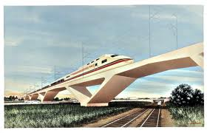
Rebuild infrastructure

Slide 34
2013 REPORT CARD FOR U.S. INFRASTRUCTURE AMERICAN SOCIETY OF CIVIL ENGINEERS
D+
Estimated investment needed by 2020, to get to a grade of B: $3.6 trillion
Jobs: Increase by 3.5 million
Personal income: Increase by $3,100 annually
GDP: Add $3.1 trillion

Slide 35
Support Green Energy and Alternative Institutions
Local
Sustainable
Publicly financed
Democratic control of energy production and distribution

Slide 36
Holding harmless the workers and communities that are now dependent on military spending

Slide 37
LOCAL PLANNING: ENCOURAGE LOCAL GOVERNMENTS TO ESTABLISH FUTURES COMMISSIONS AND TO APPLY FOR DEVELOPMENT GRANTS
Community planning: Commerce Department grants for communities undergoing dislocations--to examine new areas of economic development.
Finance: Commerce, Energy and Treasury Departments—grants for economic development focused on clean energy and transportation.

Slide 38
TRANSITION TO A PEACE ECONOMY
Fully fund education, social services & public programs
Invest in sustainable technologies, mass transit, public works & infrastructure, rehabilitate schools & housing, health care for all, and other sectors that create well-paid stable jobs
Provide income and benefit guarantees to all displaced defense industry workers until next job or retirement

Slide 39
TRANSITION TO A PEACE ECONOMY
Pay all expenses for relocation to new jobs
Fully paid retraining for comparable jobs in other sectors
Fully compensate communities for loss of tax revenues
Establish community employment investment trusts to develop alternative sources of sustainable employment
Provide comprehensive care for all injured veterans and their beneficiaries

Slide 40
UNION SUPPORT FOR ECONOMIC CONVERSION

Slide 41
AFL-CIO EXECUTIVE COUNCIL 1992
“The decline in direct military threats to the U.S. national security and the reduction in military spending require an economic conversion program for the transfer of economic resources and workers from military to civilian production. Such a program would insure that those who built the nation’s defenses need not suffer in times of peace. . . .
“Workers who have labored in jobs related to national defense needs – some in the military, some as civilian employees of the Department of Defense, and others in defense production plants or in providing auxiliary services under contract to the military – should know that their talents will be put to use in civilian production and that their families will be financially secure in the transition. . . .”

Slide 42
Conversion planning should provide for:
A national commission in which labor, industry and government together plan and coordinate conversion-related activities.
Community committees in defense-dependent areas, where labor, management and local leaders can work together to develop conversion plans.
In-plant Alternative Use Committees to engage labor and management in joint exploration of civilian market possibilities.
Economic Conversion
Sufficient advance notice of defense procurement cancellations and cut-backs to allow time to develop alternative use plans.
Appropriate funds to facilitate the planning process.

Slide 43
Incentives to help firms convert existing facilities from military to civilian use.
Plant-level technology and skill assessments to inventory the production potential of defense-related establishments.
Support for new business ventures.
Start-up funds for planning, research and development in the form of grants, loans, loan guarantees or tax incentives.
The assistance program for workers should provide for:
At least six months’ advance notice of major layoffs and/or closing of defense plants or military bases.
At least one-week of severance pay for every year of service at the affected establishment or with the employer.

Slide 44
A special federal unemployment system with benefits similar to those provided under the earlier Trade Adjustment Assistance program. This would include at least 26 weeks of regular unemployment insurance payments.
Expansion of training, retraining, relocation and placement programs, including adequate funding of the Employment Service to facilitate the conversion process.
Adequate health insurance protection for displaced workers.
Early retirement options for workers affected by defense cutbacks to be paid for out of the adjustment fund.

Slide 45
The federal government should provide funds to state and local governments to offset the loss of local taxes and federal impact aid in communities hard-hit by cutbacks at defense plants and military bases
The AFL-CIO calls upon Congress to enact legislation that provides adequate planning at the national and local level for economic conversion, effective support for business and labor to develop alternative uses of defense-oriented facilities, and appropriate assistance for workers adversely affected by cuts in military spending.
We urge Congress to allocate a significant share of federal budget savings from defense cutbacks for use in economic conversion planning and assistance.

Slide 46
IAM* CONVENTION CALLS FOR ECONOMIC CONVERSION PROGRAM (ADOPTED MAY 6, 2013)
RESOLVED . . . create and fund a working committee . . . to examine and consider various proposals for a national planned Economic Conversion Program . . .
RESOLVED . . . incorporate into our political goals the recommendations of that committee;
RESOLVED that the Local Lodges . . . of our Union coordinate political efforts with this committee and support and pursue its recommendations.
*International Association of Machinists
Notes:
Summarize: To address our current economic problems, we need to:
Cut the military budget substantially
Transfer those resources to rebuilding infrastructure and industrial capacity
Invest in green energy and alternative institutions
46

Slide 47
CWA* NATIONAL RESOLUTION ON ECONOMIC CONVERSION (APRIL 2013)
Resolved: . . . CWA supports repurposing non-essential military spending to fund programs that rebuild America through the development of new sustainable technologies and 21st century manufacturing, construction of affordable housing, modernization of our nation’s physical and social infrastructure, and the deployment of universal high-speed broadband to all Americans.
*Communication Workers of America
Source: USLAW

Slide 48
NEA* CONVENTION CALLS FOR ECONOMIC CONVERSION, AUG. 2013
The NEA . . . calls for a change in the nation's course and priorities by endorsing a national budgetary strategy that increases tax revenues for the wealthy and large corporations, emphasizes conversion from military spending to peacetime employment, creates stable jobs at living wages, linking such a program to public education . . .
*National Education Association
Source: USLAW

Slide 49
AFSCME* RESOLUTION ON ECONOMIC CONVERSION (JUNE 2012)
BE IT RESOLVED, that AFSCME calls on the U.S. Congress and the President to . . . significantly cut the Pentagon budget, and use that money to fund education, public and private sector family-sustaining job creation, special protections for military sector workers, environmental and infrastructure restoration, care for veterans and their families, and human services that our cities and states so desperately need. . . .
*American Federation of State, County and Municipal Employees
Source: USLAW

Slide 50
UE* RESOLUTION, OCT. 2009
. . . Demands that the Obama administration invest in peace by building economic security, in particular:
A substantial reduction in the military budget. . .
The immediate redeployment of these savings into the nation’s transportation system, housing, healthcare, education, environmental protection, renewable resource development, and other peaceful infrastructure . . .
The conversion of defense industries to production for industrial and consumer use . . .
*United Electrical, Radio and Machine Workers of America
Source: USLAW

Slide 51
BECAUSE WE’RE ALL IN THIS TOGETHER!

Slide 52
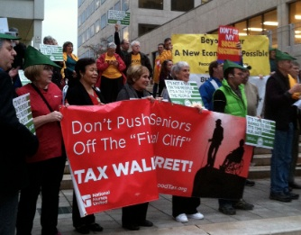
PARTNERSHIPS FOR ADVOCACY: FUND OUR COMMUNITIES, NOT THE PENTAGON

Slide 53
WHAT WOULD THE FUTURES COMMISSION DO?
Analysis, leading to a policy report
Advise the governor’s office
Advise the state legislature
Public education and public engagement
Provide opportunities for the people to plan a new economy—economic democracy
Develop strategies to help workers and communities that are dependent on military spending

Slide 54
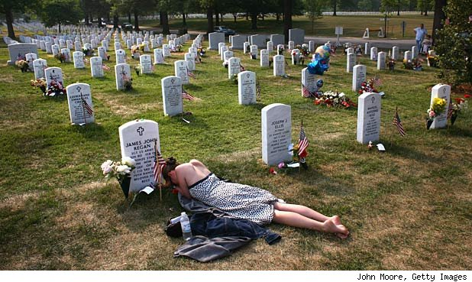
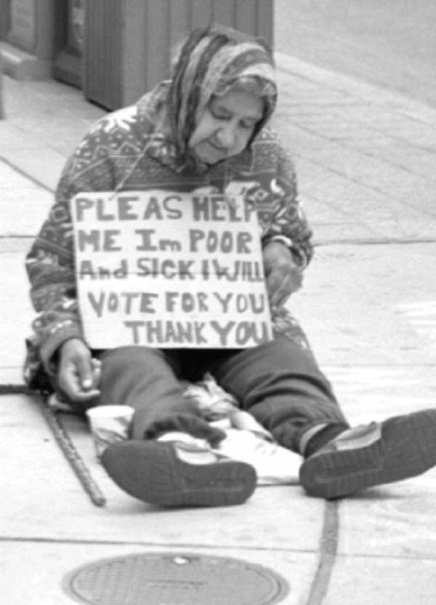
IT’S A CHOICE: ADDICTION TO MILITARISM OR A SUSTAINABLE EQUITABLE DEMILITARIZED NEW ECONOMY
54

Slide 55
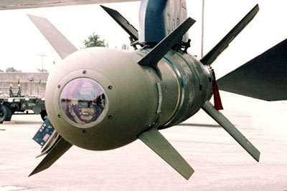
ECONOMIC CONVERSION: MOVE FROM A MILITARY-DOMINATED ECONOMY TO A CIVILIAN ECONOMY

Slide 56
SOURCES
American Society of Civil Engineers: http://sections.asce.org/maryland/civilenglinks/2011MDReportCard.htm
Bandow: http://www.cato.org/publications/commentary/us-defense-cuts-ax-needed-not-scalpel
Bloomberg: http://go.bloomberg.com/multimedia/ceo-pay-ratio/
Cato Web Site: http://www.cato.org/research/defense-budgetpolicy
Congressional Research Service, Arms Transfers: http://www.fas.org/sgp/crs/weapons/R42678.pdf
Corpwatch: http://www.corpwatch.org/article.php?id=15863
Deloitte: http://armedservices.house.gov/index.cfm/files/serve?File_id=126226cd-bc54-4e4b-a9ec-1ea16e61a2dd
Friedman & Logan: “Why the U.S. Military Budget is Foolish and Sustainable,” 2012: http://www.cato.org/research/defense-budgetpolicy
Fuller, Stephen, The Economic Impact of Sequestration Budget Cuts to DOD and Non-DOD agencies as Modified by the American Taxpayer Relief Act of 2012," Center of Regional Analysis, George Mason University, March 14, 2013.
Hartung & Peterson, “Minimum Returns: The Economic Impact of Pentagon Spending,” http://www.ciponline.org/images/uploads/publications/Hartung_IPR_0113_EconomicImpactsPentagonContracting_FINAL_02-04-13.pdf
Hellman, Chris: http://www.tomdispatch.com/post/175361/tomgram%3A_chris_hellman,_$1.2_trillion_for_national_security
Institute for Policy Studies: http://www.ips-dc.org/articles/fact_sheet_on_unified_security_budget
MD Dept of Business and Economic Development: http://www.choosemaryland.org/moveyourbusiness/Documents/B2G%20Docs/missionMd.pdfMD Dept of Business and Economic Development: http://www.choosemaryland.org/moveyourbusiness/Documents/B2G%20Docs/missionMd.pdf and http://www.chosemaryland.org/Resources/pdffiles/marylandrankingsfiles/MarylandRankings.pdf
MD Dept of Business and Economic Development: http://www.choosemaryland.org/aboutdbed/Documents/Publications/aeroDefWeb.pdf
National Priorities Project: http://nationalpriorities.org/en/interactive-data/trade-offs/041713/?state=MD&program=14
National Science Foundation, Science and Engineering Indicators, 2012, chart 4-45: http://www.nsf.gov/statistics/seind12/appendix.htm#c4
Think Progress: http://thinkprogress.org/politics/2011/03/03/147994/unions-income-inequality/
USLAW: http://www.uslaboragainstwar.org/section.php?id=57
World Bank: http://data.worldbank.org/indicator/MS.MIL.XPND.GD.ZS

